Slide 1
BootStrap

Slide 2
Introduction
Bootstrap is the most popular HTML, CSS, and JavaScript framework for developing responsive, mobile-first web sites.

Slide 3
Where to Get Bootstrap?
There are two ways to start using Bootstrap on
your own web site.
You can:
Download Bootstrap from getbootstrap.com
Include Bootstrap from a CDN
<!-- Latest compiled and minified CSS --> <link rel="stylesheet"href="http://maxcdn.bootstrapcdn.com/bootstrap/3.3.6/css/bootstrap.min.css"> <!-- jQuery library --> <script src="https://ajax.googleapis.com/ajax/libs/jquery/1.12.2/jquery.min.js"></script> <!-- Latest compiled JavaScript --> <script src="http://maxcdn.bootstrapcdn.com/bootstrap/3.3.6/js/bootstrap.min.js"></script>

Slide 4
Create First Web Page With Bootstrap
Add the HTML5 doctype
Bootstrap 3 is mobile-first
Containers
Grid System
Collapse
Jumbotron
Page Header
Navigation bar

Slide 5
1. Add the HTML5 doctype
Bootstrap uses HTML elements and CSS properties that require the HTML5 doctype.
Always include the HTML5 doctype at the beginning of the page, along with the lang attribute and the correct character set:
<!DOCTYPE html> <html lang="en"> <head> <meta charset="utf-8"> </head> </html>

Slide 6
2. Bootstrap 3 is mobile-first
Bootstrap 3 is designed to be responsive to mobile devices. Mobile-first styles are part of the core framework.
To ensure proper rendering and touch zooming, add the following <meta> tag inside the <head> element:
<meta name="viewport" content="width=device-width, initial-scale=1">

Slide 7
3. Containers
Bootstrap also requires a containing element to wrap site contents.
There are two container classes to choose from:
The .container class provides a responsive fixed width container
The .container-fluid class provides a full width container, spanning the entire width of the viewport
Demo: containerfluid-container.html

Slide 8
Bootstrap Grid System
Bootstrap's grid system allows up to 12 columns
across the page.
The Bootstrap grid system has four classes:
xs (for phones - screens less than 768px wide)
sm (for tablets - screens equal to or greater than 768px wide)
md (for small laptops - screens equal to or greater than 992px wide)
lg (for laptops and desktops - screens equal to or greater than 1200px wide)

Slide 9
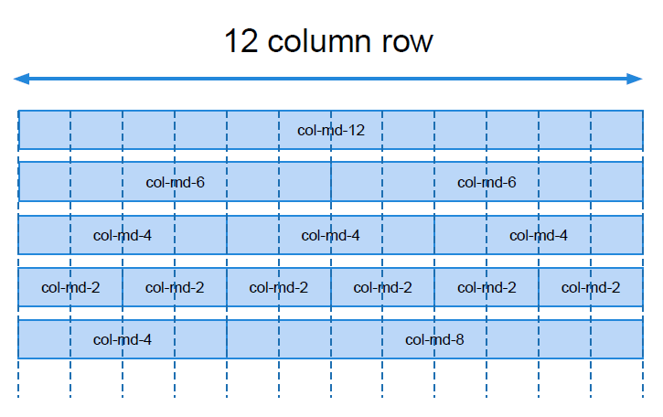
The grid layout

Slide 10
Bootstrap Grid System Example
<div class="row"> <div class="col-sm-4">.col-sm-4</div> <div class="col-sm-8">.col-sm-8</div> </div>
Demo: col-grid.html

Slide 11
Bootstrap Collapse
Collapsibles are useful when you want to hide and show large amount of content:
<button data-toggle="collapse" data-target="#demo">Collapsible</button> <div id="demo" class="collapse"> Write some text.... </div>
Demo: bs-collapse.html

Slide 12
Bootstrap JS Collapse
$(document).ready(function(){ $("#demo").on("hide.bs.collapse", function(){ $(".btn").html('<span class="glyphicon glyphicon-collapse-down"></span> Open'); }); $("#demo").on("show.bs.collapse", function(){ $(".btn").html('<span class="glyphicon glyphicon-collapse-up"></span> Close'); }); });
Demo: js-collapse.html

Slide 13
Bootstrap Jumbotron
A jumbotron indicates a big box for calling extra attention to some special content or information.
A jumbotron is displayed as a grey box with rounded corners. It also enlarges the font sizes of the text inside it.
Use a <div> element with class .jumbotron to create a jumbotron:

Slide 14
Page Header
Use a <div> element with class .page-header to create a page header:
<div class="page-header"> <h1>Example Page Header</h1> </div>
Demo: jumbotronAndHeader.html

Slide 15
Bootstrap Navigation Bar
A navigation bar is a navigation header that is placed at the top of the page:
With Bootstrap, a navigation bar can extend or collapse, depending on the screen size.
A standard navigation bar is created with <nav class="navbar navbar-default">
Demo: navbar-simple.html

Slide 16
Bootstrap Inverted Navigation Bar
If you don't like the style of the default navigation bar, Bootstrap provides an alternative, black navbar:
Just change the .navbar-default class into .navbar-inverse:
Demo:navbar-inverse.html

Slide 17
Bootstrap Fixed Navigation Bar
The navigation bar can also be fixed at the top or at the bottom of the page.
A fixed navigation bar stays visible in a fixed position (top or bottom) independent of the page scroll.
The .navbar-fixed-top class makes the navigation bar fixed at the top:
The .navbar-fixed-bottom class makes the navigation bar stay at the bottom:
Demo: navbar-fixed.html

Slide 18
Bootstrap Navigation Bar with Dropdown
Navigation bars can also hold dropdown menus.
Demo: navbar-dropdown.html

Slide 19
Bootstrap Right Aligned Navigation Bar
The .navbar-right class is used to right-align navigation bar buttons.
In the following example we insert a "Sign Up" button and a "Login" button to the right in the navigation bar. We also add a glyphicon on each of the two new buttons:
Demo: navbar-rightaligned.html

Slide 20
Collapsing The Navigation Bar
The navigation bar takes up too much space on a small screen.
We should hide the navigation bar; and only show it when it is needed.
In the following example the navigation bar is replaced by a button in the top right corner. Only when the button is clicked, the navigation bar will be displayed:
Demo: navbar-collapse.html

Slide 21
Online Resources
http://www.w3schools.com/bootstrap/bootstrap_navbar.asp
http://getbootstrap.com/
https://bootstrapdocs.com/

